Slide 1
Capstone: Age Estimation
Roy Kim

Slide 2
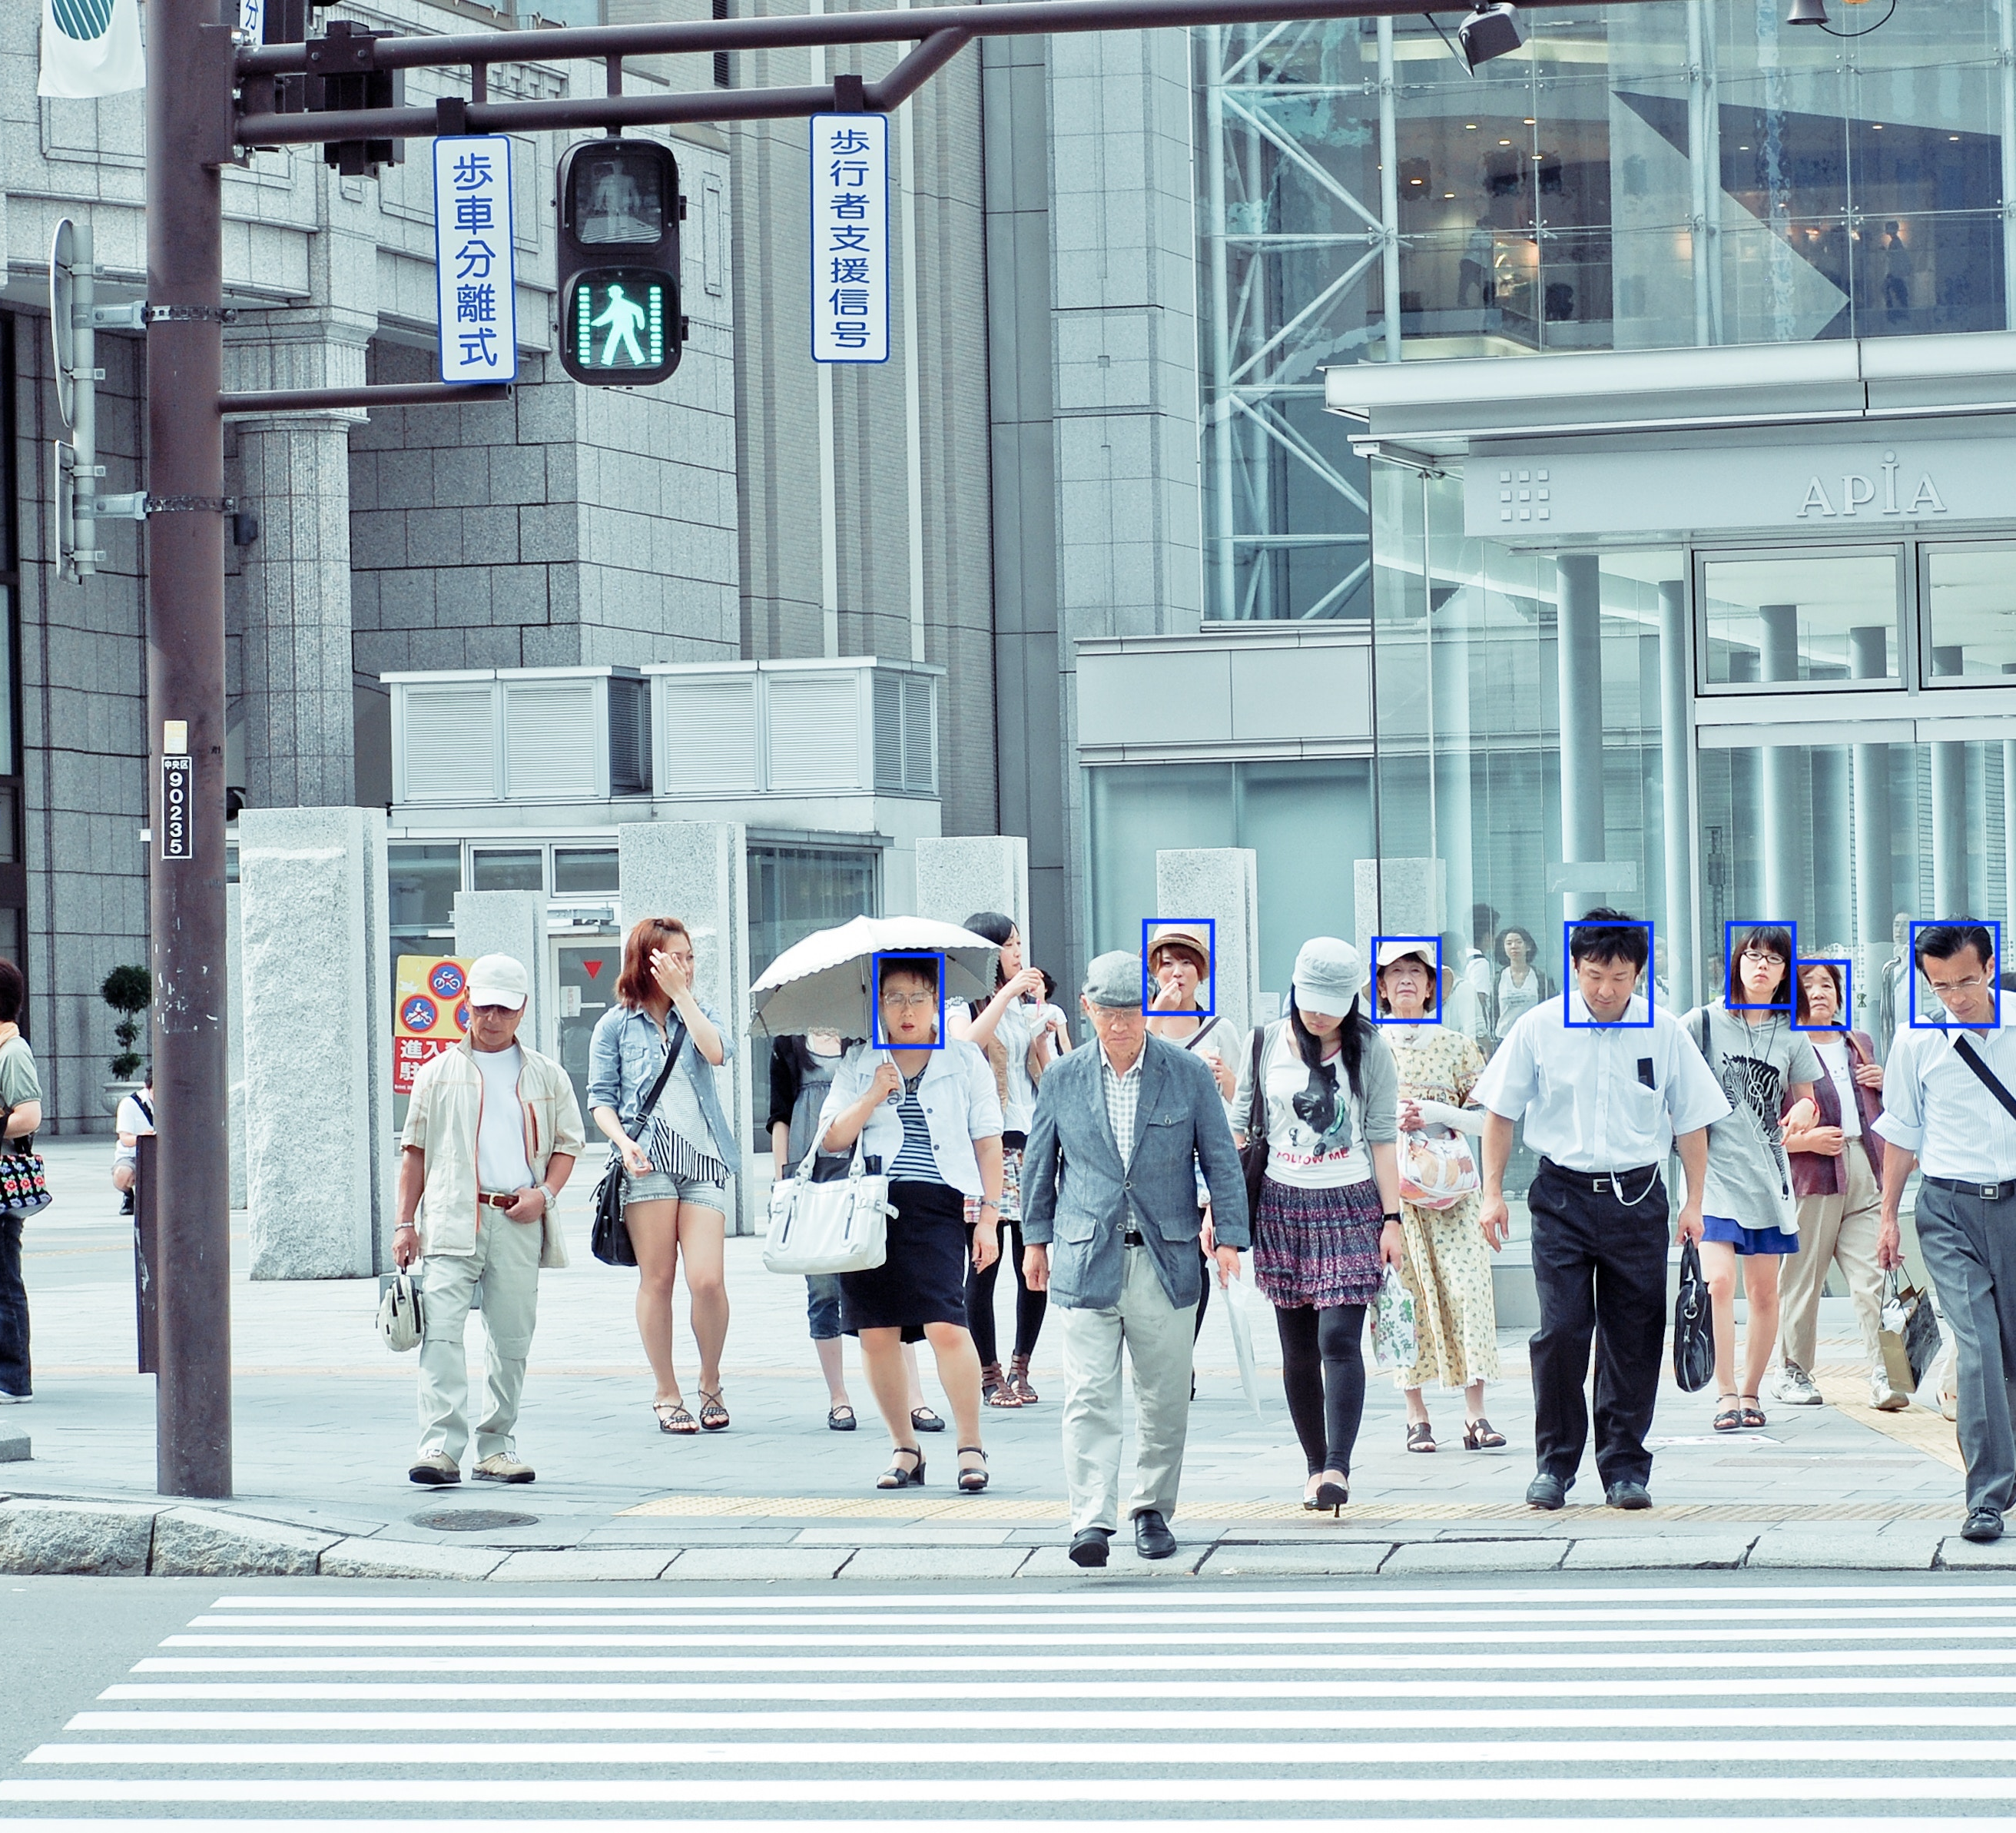
Background: Face detection
Heavy implications in government, business, advertisement
Privacy concerns
Social apps (Snapchat, Instagram)

Slide 3

Data Science Process
Define problem
Gather data
Explore data
Model with data
Evaluate data
Answer problem

Slide 4
Problem Statement
Using convolutional neural networks, I will train a classification model to predict someone’s age group based upon his/her picture. Model performance will be guided by cross entropy and accuracy (with consideration to the confusion matrix and other metrics), and the model will aim to achieve a score greater than baseline accuracy (determined by the number of classes).

Slide 5
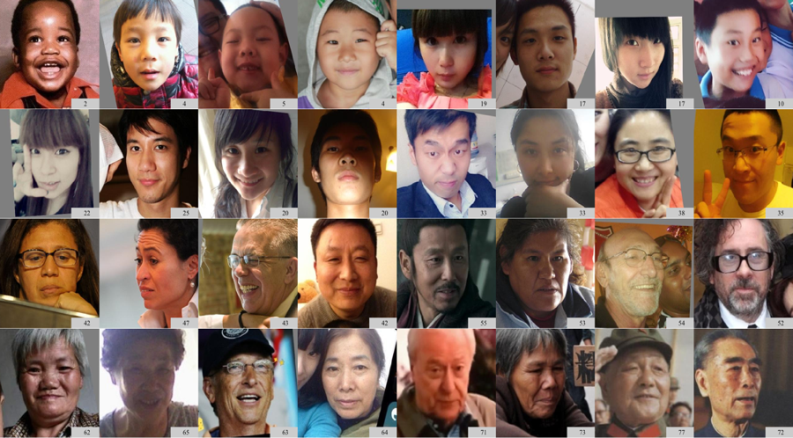
Data Retrieval
MegaAge and MegaAge Asian dataset
41,941 annotated faces in MegaAge
40,000 annotated faces in MegaAge Asian

Slide 6
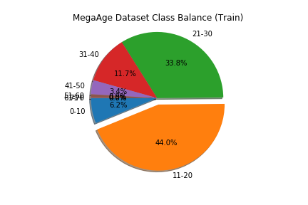
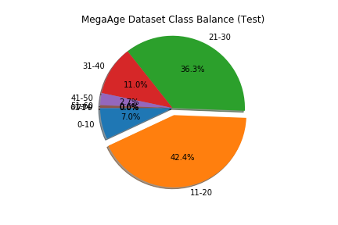
Exploring Data: Class Imbalances
First task was to classify each image into an age group programmatically
Heavy class imbalance in the MegaAge dataset, causing the combined dataset to be imbalanced

Slide 7
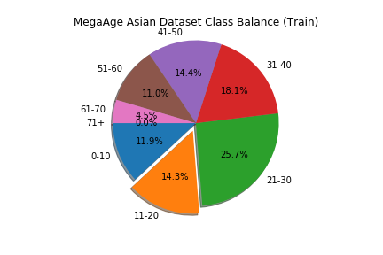
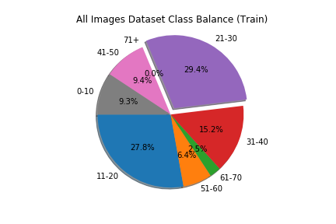
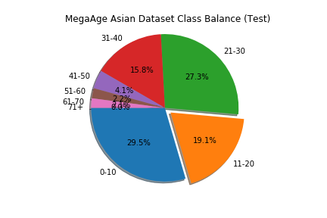
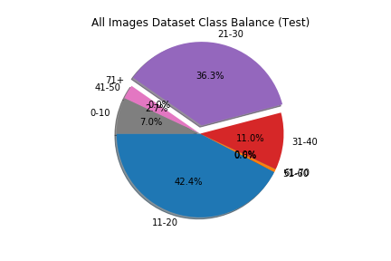

Slide 8
Modeling: Convolutional Neural Networks (CNN)
CNNs have convolutional layers that alter the dimensions of input observations, being more computational efficient than regular feed-forward neural networks for data with high dimensionality

Slide 9
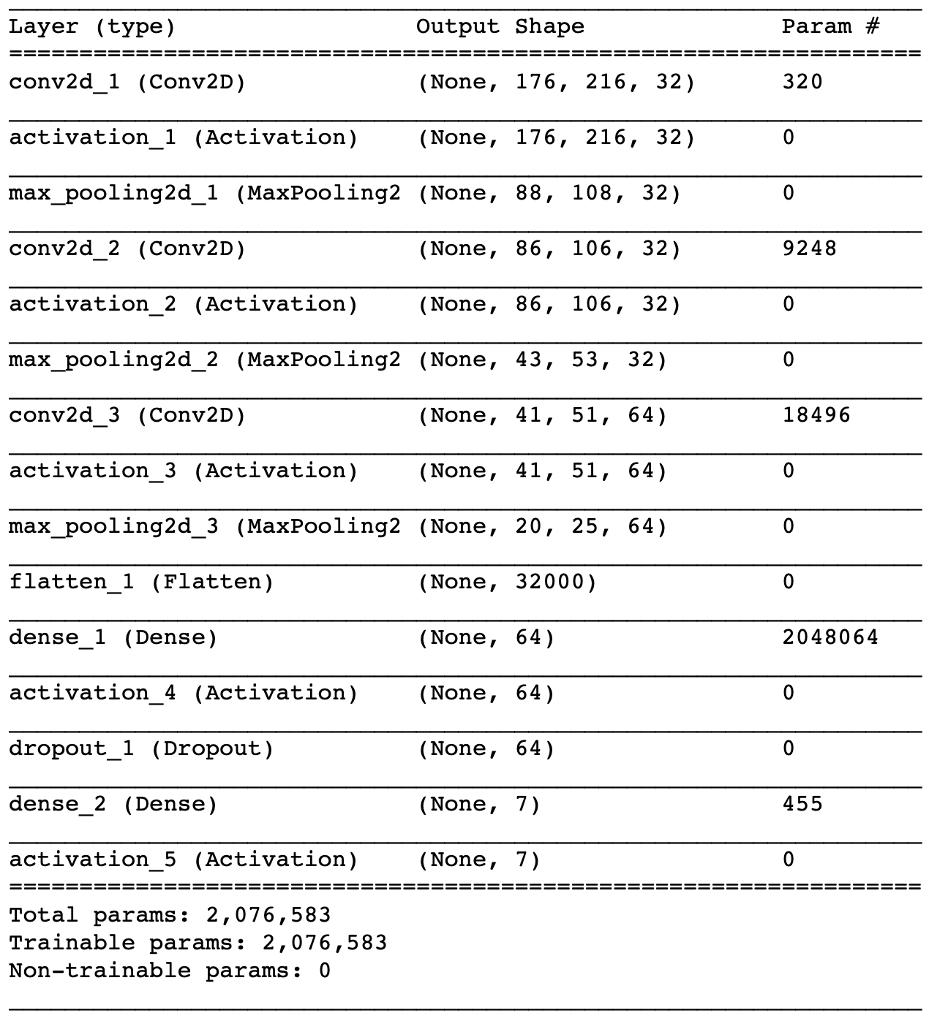
Base Model: Local and AWS
First CNN model was created from scratch
3 sets of convolutional and pooling layers, then 2 sets of dense layers to predict output

Slide 10
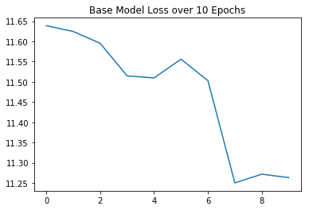
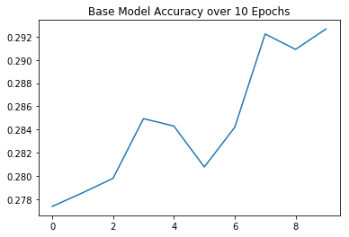
Base model performance
Leveling off of accuracy at about 29~30%
This was the baseline, meaning that the base model was not learning anything!

Slide 11
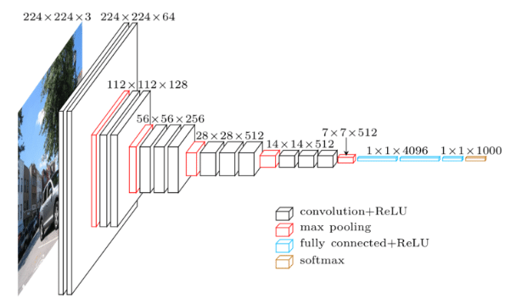
VGG-16 Face Model
Used a pre-trained model (VGG-16)
Developed by Oxford University’s Visual Geometry Group
16 layers deep
138 million parameters

Slide 12
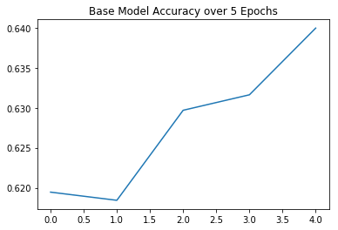
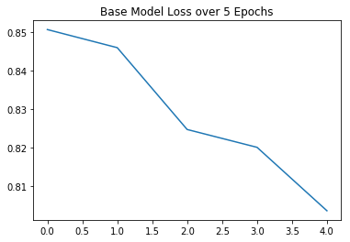
VGG-16 Model Performance
Even on AWS, each epoch took 30 minutes (each run of the model was 5 or 10 epochs)
On first run, the model was still learning nothing!
After research, I changed batch size from 16 to 32 (which controls learning rate) and model started to learn
After 20 epochs, train accuracy of 64% and cross-entropy of 0.8036

Slide 13
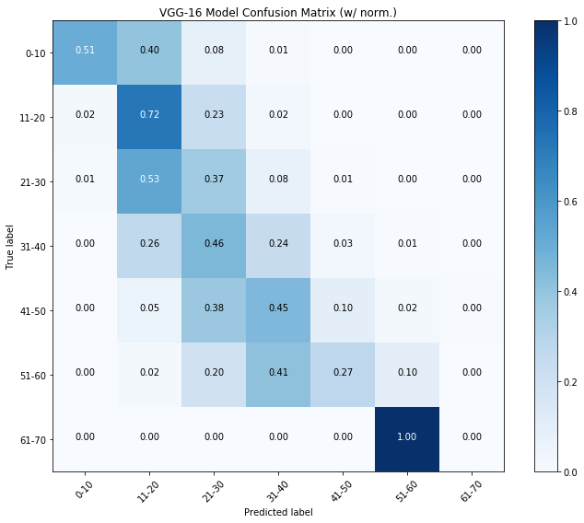
Evaluating the Model
To see if the model was learning, I created a confusion matrix
One-Off accuracy metric: 70%
Learning was stunted due to high class imbalance

Slide 14
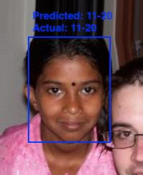
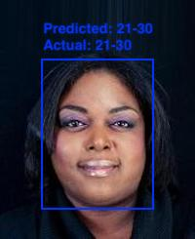
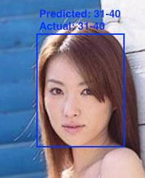
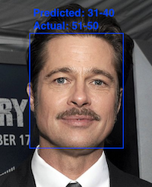
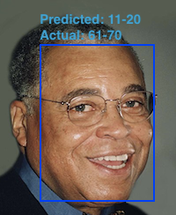
Final Predictions

Slide 15
Next Steps
Use a live video feed via OpenCV to classify someone's age group based on their face (perhaps using a computer's webcam)
Create a regression problem where the model predicts age, as opposed to age group
implementing a validation training set (instead of only having a train and test split)

Slide 16
Thank you!

